Slide 1
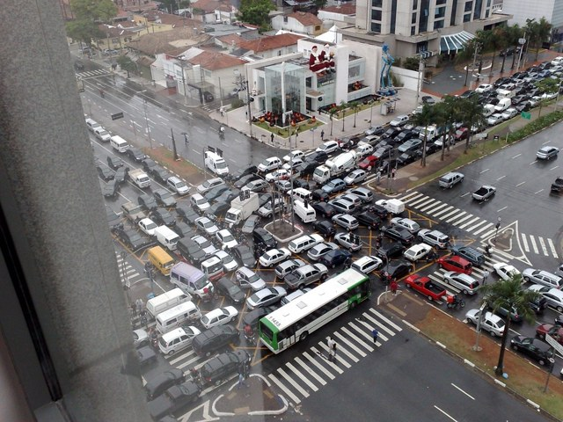
Multiprocessor Synchronization
CSCI 176
Futures, Scheduling, and Work Distribution
Lecture 20, 21
November 2024
Maurice Herlihy
Brown University

Slide 2
How to write Parallel Apps?
Split a program into parallel parts
In an effective way
Thread management
2
Notes:
2
In this chapter we how to decompose certain kinds of problems into components that can be executed in parallel. Some applications break down naturally into parallel threads. For example, when a request arrives at a web server, the server can just create a thread (or assign an existing thread) to handle the request. Applications that can be structured as producers and consumers also tend to be easily parallelizable. In this chapter, however, we look at applications that have inherent parallelism, but where it is not obvious how to take advantage of it.

Slide 3
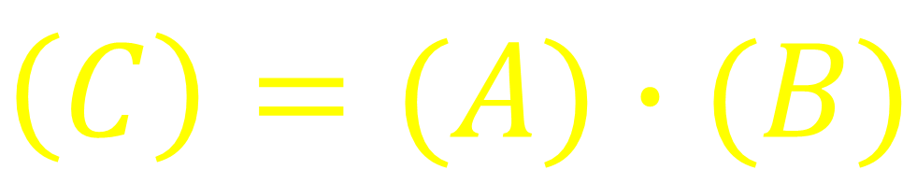
Matrix Multiplication
$$\left(C\right)=(A)∙(B)$$
3
Notes:
3
To take another specific example, let’s look at matrix multiplication, one of the most common and important applications in scientific computing.

Slide 4
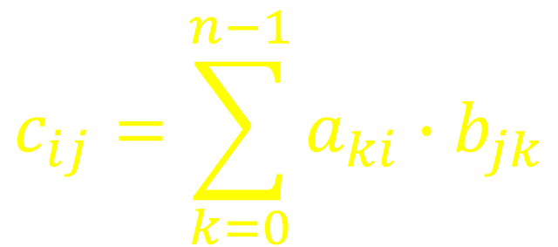
Matrix Multiplication
$$c_{ij}=\sum_{k=0}^{n−1}{a_{ki}∙b_{jk}}$$
No synchronization!
Massive parallelism!

Slide 5
Matrix Multiplication
class Worker extends Thread {
int row, col;
Worker(int row, int col) {
row = row; col = col;
}
public void run() {
double dotProduct = 0.0;
for (int i = 0; i < n; i++)
dotProduct += a[row][i] * b[i][col];
c[row][col] = dotProduct;
}}}
Notes:
5
Here is a worker thread. The worker in position $(i,j)$ computes $c_{ij}$.

Slide 6
Matrix Multiplication
class Worker extends Thread {
int row, col;
Worker(int row, int col) {
row = row; col = col;
}
public void run() {
double dotProduct = 0.0;
for (int i = 0; i < n; i++)
dotProduct += a[row][i] * b[i][col];
c[row][col] = dotProduct;
}}}
a subtype of thread
Notes:
6
A worker is a thread, meaning that it runs concurrently with other threads.

Slide 7
Matrix Multiplication
class Worker extends Thread {
int row, col;
Worker(int row, int col) {
row = row; col = col;
}
public void run() {
double dotProduct = 0.0;
for (int i = 0; i < n; i++)
dotProduct += a[row][i] * b[i][col];
c[row][col] = dotProduct;
}}}
Which matrix entry to compute
Notes:
7
Each worker thread is given the coordinates of the term it computes.

Slide 8
Matrix Multiplication
class Worker extends Thread {
int row, col;
Worker(int row, int col) {
row = row; col = col;
}
public void run() {
double dotProduct = 0.0;
for (int i = 0; i < n; i++)
dotProduct += a[row][i] * b[i][col];
c[row][col] = dotProduct;
}}}
Actual computation
Notes:
8
Here is the actual computation.

Slide 9
Matrix Multiplication
void multiply() {
Worker[][] worker = new Worker[n][n];
for (int row …)
for (int col …)
worker[row][col] = new Worker(row,col);
for (int row …)
for (int col …)
worker[row][col].start();
for (int row …)
for (int col …)
worker[row][col].join();
}
Notes:
9
Here is the driver code

Slide 10
Matrix Multiplication
void multiply() {
Worker[][] worker = new Worker[n][n];
for (int row …)
for (int col …)
worker[row][col] = new Worker(row,col);
for (int row …)
for (int col …)
worker[row][col].start();
for (int row …)
for (int col …)
worker[row][col].join();
}
Create n x n threads
Notes:
10
First we create an n-by-n array of threads …

Slide 11
Matrix Multiplication
void multiply() {
Worker[][] worker = new Worker[n][n];
for (int row …)
for (int col …)
worker[row][col] = new Worker(row,col);
for (int row …)
for (int col …)
worker[row][col].start();
for (int row …)
for (int col …)
worker[row][col].join();
}
Start them
What’s wrong with this picture?
Wait for them to finish
Notes:
11
Then we wait for them to finish. When they’re done, so are we.

Slide 12
Thread Overhead
Threads require resources
Memory for stacks
Setup, teardown
Scheduler overhead
Short-lived threads
Bad ratio of work versus overhead
Notes:
12
In practice, however, while this design might perform for small matrices, it would perform very poorly for matrices large enough to be interesting. Here is why: threads require memory for stacks and other bookkeeping information Creating, scheduling, and destroying threads takes a substantial amount of computation. Creating lots of short-lived threads is an inefficient way to organize a multi-threaded computation.

Slide 13
Thread Pools
More sensible to keep a pool of long-lived threads
Thread:
Assigned a short-lived task
Run the task
Rejoin pool & wait for next assignment
Notes:
13
A more effective way to organize such a program is to create a pool of long-lived threads. Each thread in the pool repeatedly waits until it is assigned a task, a short-lived unit of computation. When a thread is assigned a task, it executes that task, and then rejoins the pool to await its next assignment. Thread pools can be platform-dependent: it makes sense for large-scale multiprocessors to provide large pools, and vice-versa. Thread pools avoid the cost of creating and destroying threads in response to short-lived fluctuations in demand.

Slide 14
Thread Pool = Abstraction
Insulate programmer from platform
Big machine, big pool
Small machine, small pool
Portable code
Works across platforms
Worry about algorithm, not platform
Notes:
14
In addition to performance benefits, thread pools have another equally important, but less obvious advantage: they insulate the application programmer from platform-specific details such as the number of concurrent threads that can be scheduled efficiently. Thread pools make it possible to write a single program that runs equally well on a uniprocessor, a small-scale multiprocessor, and a large-scale multiprocessor. Thread pools provide a simple interface that hides complex, platform-dependent engineering trade-offs.

Slide 15
ExecutorService Interface
Package java.util.concurrent
No result value expected?
Task = Runnable object
Work = void run().
Type T result expected?
Task = Callable<T> object
Work = T call()
Notes:
15
In Java, a thread pool is called an executor service. It provides the ability to submit a task, to wait for a set of submitted tasks to complete, and to cancel uncompleted tasks. A task that does not return a result is usually represented as a Runnable object, where the work is performed by a run{} method that takes no arguments and returns no results. A task that returns a value of type T is usually represented as a callable<T> object, where the result is returned by a T call() method that takes no arguments.

Slide 16
Future<T>
Callable<T> task = …;
…
Future<T> future = executor.submit(task);
…
T value = future.get();
Notes:
16
Here is how to use an executor service to compute a value asynchronously.

Slide 17
Future<T>
Callable<T> task = …;
…
Future<T> future = executor.submit(task);
…
T value = future.get();
Submitting a Callable<T> task returns a Future<T> object
Notes:
17
When a Callable<T> object is submitted to an executor service, the service returns an object implementing the Future<T> interface.

Slide 18
Future<T>
Callable<T> task = …;
…
Future<T> future = executor.submit(task);
…
T value = future.get();
The Future’s get() method blocks until the value is available
Notes:
18
The Future provides a get() method that returns the result, blocking if necessary until the result is ready. (It also provides methods for canceling uncompleted computations, and for testing whether the computation is complete.)

Slide 19
Future<?>
Runnable task = …;
…
Future<?> future = executor.submit(task);
…
future.get();
Submitting a Runnable task returns a Future<?> object
Notes:
19
What if we want to run an asynchronous computation that does not return a value?

Slide 20
Future<?>
Runnable task = …;
…
Future<?> future = executor.submit(task);
…
future.get();
The Future’s get() method blocks until the computation is complete (no return value)
Notes:
20
What if we want to run an asynchronous computation that does not return a value?

Slide 21
Warning
Executor Service requests …
Like New England traffic signs
Are purely advisory in nature
The executor
Like the Boston driver
Is free to ignore any such advice
And could execute tasks sequentially …
21
Notes:
21
The important thing to understand is that spawn and sync are suggestions to the OS, not commands. In fact, we do not have direct control over how the OS does scheduling. What we are saying is “if there are n processors, then here is work they could do in parallel”

Slide 22
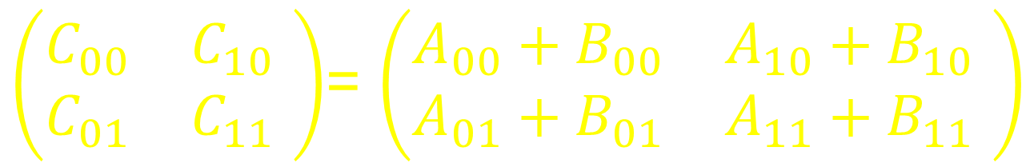
Matrix Addition
$\left(\begin{matrix}C_{00} & C_{10} \\ C_{01} & C_{11}\end{matrix} \right)$= $\left(\begin{matrix}A_{00}+B_{00} & A_{10}+B_{10} \\ A_{01}+B_{01} & A_{11}+B_{11}\end{matrix} \right)$
4 parallel additions
22
Notes:
22
For now, let’s look at the details of how to do matrix addition in parallel. Matrix multiplication, which is far more interesting, is covered in the text.

Slide 23
Matrix Addition Task
class AddTask implements Runnable {
Matrix a, b; // add this!
public void run() {
if (a.dim == 1) {
c[0][0] = a[0][0] + b[0][0]; // base case
} else {
(partition a, b into half-size matrices aij and bij)
Future<?> f00 = exec.submit(addTask(a00,b00));
…
Future<?> f11 = exec.submit(addTask(a11,b11));
f00.get(); …; f11.get();
…
23
Notes:
23
Let’s look at how one would do matrix addition using a thread pool. The above is not actual working Java code, and the reader should look at the textbook for the detailed working code.

Slide 24
Matrix Addition Task
class AddTask implements Runnable {
Matrix a, b; // add this!
public void run() {
if (a.dim == 1) {
c[0][0] = a[0][0] + b[0][0]; // base case
} else {
(partition a, b into 4 half-size matrices a_{ij,}b_{ij})
Future<?> f₀₀ = exec.submit(addTask(a₀₀,b₀₀));
Future<?> f₀₁ = exec.submit(addTask(a₀₁,b₀₁));
Future<?> f₁₀ = exec.submit(addTask(a₁₀,b₁₀));
Future<?> f₁₁ =,exec.submit(addTask(a₁₁,b₁₁));
f₀₀.get(); f₀₁.get(); f₁₀.get(); f₁₁.get();
…
Base case: add directly
Notes:
24
The matrix addition program is recursive. When we get to the bottom, do the additions directly. Here we show the recursion bottoming out at dimension 1. In practice, it makes sense to bottom out at a larger number. The code here is a simplified version of the code in the textbook that shows the details of how the split is performed.

Slide 25
Matrix Addition Task
class AddTask implements Runnable {
Matrix a, b; // add this!
public void run() {
if (a.dim == 1) {
c[0][0] = a[0][0] + b[0][0]; // base case
} else {
(partition a, b into 4 half-size matrices a_{ij,}b_{ij})
Future<?> f₀₀ = exec.submit(addTask(a₀₀,b₀₀));
Future<?> f₀₁ = exec.submit(addTask(a₀₁,b₀₁));
Future<?> f₁₀ = exec.submit(addTask(a₁₀,b₁₀));
Future<?> f₁₁ =,exec.submit(addTask(a₁₁,b₁₁));
f₀₀.get(); f₀₁.get(); f₁₀.get(); f₁₁.get();
…
Constant-time operation
Notes:
25
We can split a matrix into half-size matrices in constant time by manipulating indexes and offsets.

Slide 26
Matrix Addition Task
class AddTask implements Runnable {
Matrix a, b; // add this!
public void run() {
if (a.dim == 1) {
c[0][0] = a[0][0] + b[0][0]; // base case
} else {
(partition a, b into 4 half-size matrices a_{ij,}b_{ij})
Future<?> f₀₀ = exec.submit(addTask(a₀₀,b₀₀));
Future<?> f₀₁ = exec.submit(addTask(a₀₁,b₀₁));
Future<?> f₁₀ = exec.submit(addTask(a₁₀,b₁₀));
Future<?> f₁₁ =,exec.submit(addTask(a₁₁,b₁₁));
f₀₀.get(); f₀₁.get(); f₁₀.get(); f₁₁.get();
…
Submit 4 tasks
Notes:
26
Each recursive call returns a Future<?>, meaning that we call it for its side-effects, not its return value.

Slide 27
Matrix Addition Task
class AddTask implements Runnable {
Matrix a, b; // add this!
public void run() {
if (a.dim == 1) {
c[0][0] = a[0][0] + b[0][0]; // base case
} else {
(partition a, b into 4 half-size matrices a_{ij,}b_{ij})
Future<?> f₀₀ = exec.submit(addTask(a₀₀,b₀₀));
Future<?> f₀₁ = exec.submit(addTask(a₀₁,b₀₁));
Future<?> f₁₀ = exec.submit(addTask(a₁₀,b₁₀));
Future<?> f₁₁ =,exec.submit(addTask(a₁₁,b₁₁));
f₀₀.get(); f₀₁.get(); f₁₀.get(); f₁₁.get();
…
Let them finish
Notes:
27
After launching all of these parallel tasks, we now evaluate each of the futures, meaning that we wait until the tasks are complete.

Slide 28
Dependencies
Matrix add is not typical!
Because tasks are independent
Don’t need results of one task …
To complete another
Usually, tasks are not independent
Notes:
28
The matrix example uses futures only to signal when a task is complete. Futures can also be used to pass values from completed tasks. To illustrate this use of futures, we consider how to decompose the well-known Fibonacci function into a multithreaded program.

Slide 29
Fibonacci
1 if n = 0 or 1
F(n)
F(n-1) + F(n-2) otherwise
Note
Potential parallelism
Dependencies
29
Notes:
29
To illustrate another use of futures, we consider how to decompose the well-known Fibonacci function into a multithreaded program.

Slide 30
Disclaimer
This Fibonacci implementation is egregiously inefficient
So don’t try this at home or job!
But illustrates our point
How to deal with dependencies
Exercise: Make this implementation efficient!
30
Notes:
30

Slide 31
Multithreaded Fibonacci
class FibTask implements Callable<Integer> {
static ExecutorService exec
= Executors.newCachedThreadPool();
int arg;
public FibTask(int n) {
arg = n;
}
public Integer call() {
if (arg > 2) {
Future<Integer> left
= exec.submit(new FibTask(arg-1));
Future<Integer> right
= exec.submit(new FibTask(arg-2));
return left.get() + right.get();
} else {
return 1;
}}}
Notes:
31
Here is the code for a simple Fibonacci program. Of course, this is not actually an effective way to compute
Fibonacci numbers, but it is a nice simple example.

Slide 32
Multithreaded Fibonacci
class FibTask implements Callable<Integer> {
static ExecutorService exec
= Executors.newCachedThreadPool();
int arg;
public FibTask(int n) {
arg = n;
}
public Integer call() {
if (arg > 2) {
Future<Integer> left
= exec.submit(new FibTask(arg-1));
Future<Integer> right
= exec.submit(new FibTask(arg-2));
return left.get() + right.get();
} else {
return 1;
}}}
Parallel calls
Notes:
32
Here is the code for a simple Fibonacci program. Of course, this is not actually an effective way to compute
Fibonacci numbers, but it is a nice simple example.

Slide 33
Multithreaded Fibonacci
class FibTask implements Callable<Integer> {
static ExecutorService exec
= Executors.newCachedThreadPool();
int arg;
public FibTask(int n) {
arg = n;
}
public Integer call() {
if (arg > 2) {
Future<Integer> left
= exec.submit(new FibTask(arg-1));
Future<Integer> right
= exec.submit(new FibTask(arg-2));
return left.get() + right.get();
} else {
return 1;
}}}
Wait for & combine results
Notes:
33
Here is the code for a simple Fibonacci program. Of course, this is not actually an effective way to compute
Fibonacci numbers, but it is a nice simple example.

Slide 34
The Blumofe-Leiserson DAG Model
Multithreaded program is
A directed acyclic graph (DAG)
That unfolds dynamically
Each node is a single unit of work
34
Notes:
34
Formally, we can model a multithreaded program as a directed acyclic graph, where each node in the graph is a step of the program. A thread in this model is just a maximal sequence of instructions that doesn’t include spawn, synch, or return statements.

Slide 35
Fibonacci DAG
fib(4)
35
Notes:
35
Here is the DAG for the Fib program we saw earlier. Each circle is a thread. Each black horizontal arrow is a sequential dependency (the code says to do this before that). The red downward arrows represent spawn calls, and the green upward arrows indicate where the child thread rejoins the parent

Slide 36
Fibonacci DAG
fib(4)
fib(3)
36
Notes:
36
Here is the DAG for the Fib program we saw earlier. Each circle is a thread. Each black horizontal arrow is a sequential dependency (the code says to do this before that). The red downward arrows represent spawn calls, and the green upward arrows indicate where the child thread rejoins the parent

Slide 37
Fibonacci DAG
fib(4)
fib(3)
fib(2)
fib(2)
37
Notes:
37
Here is the DAG for the Fib program we saw earlier. Each circle is a thread. Each black horizontal arrow is a sequential dependency (the code says to do this before that). The red downward arrows represent spawn calls, and the green upward arrows indicate where the child thread rejoins the parent

Slide 38
Fibonacci DAG
fib(4)
fib(3)
fib(2)
fib(2)
fib(1)
fib(1)
fib(1)
fib(1)
fib(1)
38
Notes:
38
Here is the DAG for the Fib program we saw earlier. Each circle is a thread. Each horizontal arrow is a sequential dependency (the code says to do this before that). The red downward arrows represent spawn calls, and the green upward arrows indicate where the child thread rejoins the parent

Slide 39
Fibonacci DAG
fib(4)
get
call
fib(3)
fib(2)
fib(2)
fib(1)
fib(1)
fib(1)
fib(1)
fib(1)
39
Notes:
39
Here is the DAG for the Fib program we saw earlier. Each circle is a thread. Each black horizontal arrow is a sequential dependency (the code says to do this before that). The red downward arrows represent spawn calls, and the green upward arrows indicate where the child thread rejoins the parent

Slide 40
How Parallel is That?
Define work:
Total time on one processor
Define span (a.k.a critical-path length):
Longest dependency path
Never faster than that!
40
Notes:
40

Slide 41
Unfolded DAG

Slide 42
Parallelism?
Serial fraction = 3/18 = 1/6 …
Amdahl’s Law says speedup cannot exceed 6.

Slide 43
Work?
1
2
T₁: time needed on one processor
3
4
5
7
Just count the nodes ….
7
8
9
10
11
12
13
14
15
16
17
T₁ = 18
18

Slide 44
Critical Path?
T∞: time needed on as many processors as you like

Slide 45
Critical Path?
1
2
T∞: time needed on as many processors as you like
3
4
Longest path ….
5
6
7
8
T∞ = 9
9

Slide 46
Notation Watch
T_{P} = time on P processors
T₁ = work (time on 1 processor)
T∞ = critical path length (time on ∞ processors)
46
Notes:
46
It is convenient to define the following notion. Let T_{P} denote the time needed to execute a particular program on P processors (which program will be clear from context). Two special values are of particular interest. The work, T₁, is the time it would take on a single processor, with no parallelism. The critical path length, T∞ , is the time it would take on an unbounded number of processors. No matter how many resources we have or how rich we are, the critical path length limits how quickly we can execute this program.

Slide 47
Simple Laws
Work Law: T_{P} ≥ T₁/P
In one step, can’t do more than P work
Critical Path Law: T_{P} ≥ T∞
Can’t beat infinite resources
47
Notes:
47
Here are a few simple observations. First, buying P processors isn’t going to speed up your application by more than P. Another way to think about this is that P processors can do at most P work in one time step. Second, the time to execute a program on P processors cannot be less than the time to execute the program on an unbounded number of processors.

Slide 48
Performance Measures
Speedup on P processors
Ratio T₁/T_{P}
How much faster with P processors
Linear speedup
T₁/T_{P} = Θ(P)
Max speedup (average parallelism)
T₁/T∞
48
Notes:
48
The speedup on P processors is just the ratio between how long it takes with one processor and how long it takes with P. Programs with long critical paths will have poorer speedups than programs with shorter critical paths. We say a program has linear speedup if the speedup is proportional to the number of processors. This is the best we can do. Sometimes you hear people talk of “superlinear speedup”, where using P processes speeds up a computation by a factor of more than P. This phenomenon happens some times with parallel searches where the first processor to find a match halts the computation.
The maximum possible speedup is the ratio between the work and the critical path length. This quantity is often called the average parallelism, or just the parallelism.

Slide 49
Sequential Composition
A
B
Work: T₁(A) + T₁(B)
Critical Path: T∞ (A) + T∞ (B)

Slide 50
Parallel Composition
A
B
Work: T₁(A) + T₁(B)
Critical Path: max{T∞(A), T∞(B)}

Slide 51
Matrix Addition Review
$\left(\begin{matrix}C_{00} & C_{10} \\ C_{01} & C_{11}\end{matrix} \right)$= $\left(\begin{matrix}A_{00}+B_{00} & A_{10}+B_{10} \\ A_{01}+B_{01} & A_{11}+B_{11}\end{matrix} \right)$
4 parallel additions
51
Notes:
51
For now, let’s look at the details of how to do matrix addition in parallel. Matrix multiplication, which is far more interesting, is covered in the text.

Slide 52
Addition
Let A_{P}(n) be running time
For n x n matrix on P processors
For example
A₁(n) is work
A∞(n) is critical path length
52
Notes:
52
Let’s see if we can analyze the running time for adding two matrices in this model. Define A_{p}(n) to be the time needed to add two n X n matrices on P processes. Two special cases of interest are A₁(n), the overall work needed to do the addition, and A∞(n), the critical path length.

Slide 53
Addition Work
Partition, synch, etc
A₁(n) = 4 A₁(n/2) + Θ(1)
4 spawned additions
53
Notes:
53
The work is easy to compute. To add two n X n matrices, you need to add 4 half-size matrices, plus some change. The change is just the cost of partitioning the matrix, synchronizing, etc., which is constant.

Slide 54
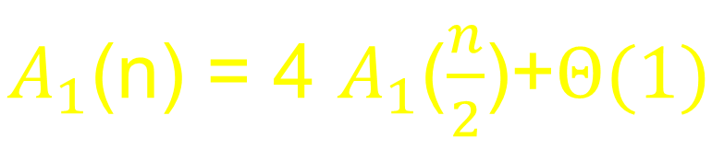
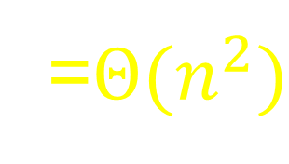
Addition Work
$A_{1}$(n) = 4 $A_{1}$($\frac{n}{2}$)+$Θ(1)$
=$Θ{(n}^{2})$
Same as double-loop summation
54
Notes:
54
You can solve this recurrence using standard methods
A₁(n) = 4 A₁(n/2) + Θ(1) = 4(4A₁(n/4)+O(1)) + O(1) = 2^{2logn}+log n = n²+log n = O(n²)
and it turns out that the overall work for adding two n X n matrices is about n², same as the usual double-loop summation, which is reassuring, because anything much better or worse would be alarming. (Why?)

Slide 55
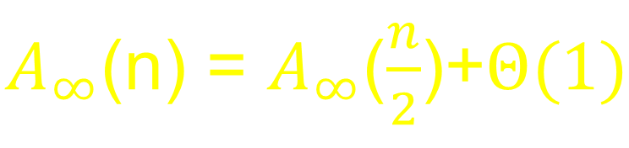
Addition Span
Partition, synch, etc
$A_{∞}$(n) = $A_{∞}$($\frac{n}{2}$)+$Θ(1)$
spawned additions in parallel
55
Notes:
55
Computing the span length is different from computing the work in one important respect: we can use all the parallelism we want. In this case, all the half-size additions are done in parallel, so we only count one half-size addition, not four. We still have the constant overhead because partition and so on are not done in parallel with the addition.

Slide 56
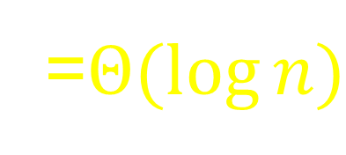
Addition Span
$A_{∞}$(n) = $A_{∞}$($\frac{n}{2}$)+$Θ(1)$
=$Θ(\log{n})$
56
Notes:
56
You can solve this recurrence using standard methods
A₁(n) = 4 A₁(n/2) + Θ(1) = 4(4A₁(n/4)+O(1)) + O(1) = 2^{2logn}+log n = n²+log n = O(n²)
and it turns out that the overall work for adding two n X n matrices is about n², same as the usual double-loop summation, which is reassuring, because anything much better or worse would be alarming. (Why?)

Slide 57

Matrix Multiplication
$$\left(C\right)=(A)∙(B)$$
57
Notes:
57
To take another specific example, let’s look at matrix multiplication, one of the most common and important applications in scientific computing.

Slide 58
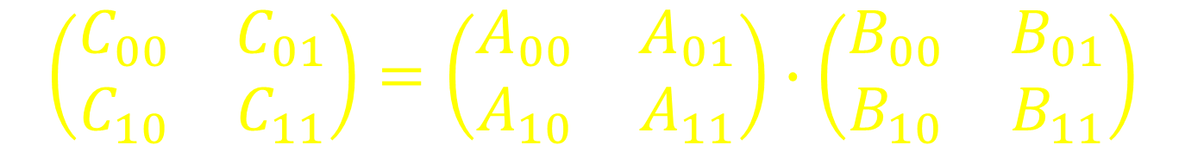
Matrix Multiplication Redux
$$\left(\begin{matrix}C_{00} & C_{01} \\ C_{10} & C_{11}\end{matrix}\right)=\left(\begin{matrix}A_{00} & A_{01} \\ A_{10} & A_{11}\end{matrix}\right)∙\left(\begin{matrix}B_{00} & B_{01} \\ B_{10} & B_{11}\end{matrix}\right)$$
58
Notes:
58
Let’s return to the problem of matrix multiplication.

Slide 59
Matrix Multiplication Redux
$$\left(\begin{matrix}C_{00} & C_{01} \\ C_{10} & C_{11}\end{matrix}\right)=\left(\begin{matrix}A_{00}B_{00}+A_{01}B_{10} & A_{00}B_{01}+A_{01}B_{11} \\ A_{10}B_{00}+A_{11}B_{10} & A_{10}B_{01}+A_{11}B_{10}\end{matrix}\right)$$
59
Notes:
59
Let’s return to the problem of matrix multiplication.

Slide 60
Matrix Multiplication Redux
$$\left(\begin{matrix}C_{00} & C_{01} \\ C_{10} & C_{11}\end{matrix}\right)=\left(\begin{matrix}A_{00}B_{00}+A_{01}B_{10} & A_{00}B_{01}+A_{01}B_{11} \\ A_{10}B_{00}+A_{11}B_{10} & A_{10}B_{01}+A_{11}B_{10}\end{matrix}\right)$$
Phase 1: 8 multiplications
60
Notes:
60
Let’s return to the problem of matrix multiplication.

Slide 61
Matrix Multiplication Redux
$$\left(\begin{matrix}C_{00} & C_{01} \\ C_{10} & C_{11}\end{matrix}\right)=\left(\begin{matrix}A_{00}B_{00}+A_{01}B_{10} & A_{00}B_{01}+A_{01}B_{11} \\ A_{10}B_{00}+A_{11}B_{10} & A_{10}B_{01}+A_{11}B_{10}\end{matrix}\right)$$
Phase 2: 4 additions
61
Notes:
61
Let’s return to the problem of matrix multiplication.

Slide 62
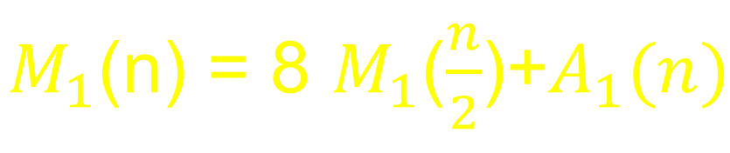
Multiplication Work
Final addition
$M_{1}$(n) = 8 $M_{1}$($\frac{n}{2}$)+$A_{1}(n)$
8 parallel multiplications
62
Notes:
62
When we solve the recurrence, it turns out that the total work is order of n cubed, which is the same work we would do in a straightforward, non-concurrent triply-nested loop.

Slide 63
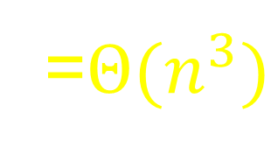
Multiplication Work
$M_{1}$(n) = 8 $M_{1}$($\frac{n}{2}$)+$A_{1}(n)$
=$Θ{(n}^{3})$
Same as serial triple-nested loop
63
Notes:
63
When we solve the recurrence, it turns out that the total work is order of n cubed, which is the same work we would do in a straightforward, non-concurrent triply-nested loop.

Slide 64
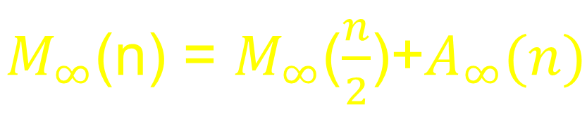
Multiplication Span
Final addition
$M_{∞}$(n) = $M_{∞}$($\frac{n}{2}$)+$A_{∞}(n)$
Half-size parallel multiplications
64
Notes:
64
The critical path length is also easy to compute. The 8 half-size multiplications are done in parallel, so we charge for the once. The final addition takes place after the multiplications are all complete, so we have to add that in as well.

Slide 65
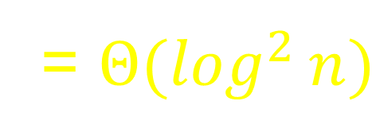
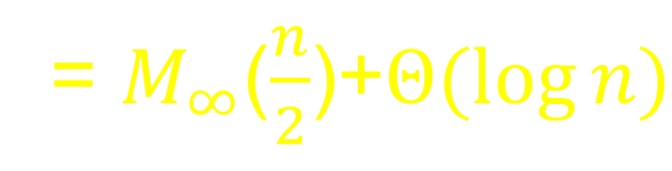
Multiplication Span
$M_{∞}$(n) = $M_{∞}$($\frac{n}{2}$)+$A_{∞}(n)$
= $M_{∞}$($\frac{n}{2}$)+$Θ(\log{n})$
= $Θ(\log^{2}{n})$
65
Notes:
65
Solving the recurrence shows that the critical path length is about log-squared n, which is pretty small.

Slide 66
Parallelism
M₁(n)/ M∞(n) = Θ(n³/log² n)
To multiply two 1000 x 1000 matrices
1000³/10²=10⁷
Much more than number of processors on any real machine
66
Notes:
66
Now here is something interesting. Remember that the parallelism is the ratio between the problem’s work and its critical path. It is a rough measure of how may processors we can keep busy on this kind of problem. For matrix multiplication, the numerator is n-cubed, and the denominator is log-squared n, which is pretty large. For example, to multiply two 1000 X 1000 matrices we get a parallelism of about ten million. (Notice that the log is base-2, and log base-two of 1000 is about 10). This calculation suggests that we can keep roughly ten million processors busy multiplying matrices of this size. Of course, this vastly exceeds the number of processors you are likely to find on any real machine any time soon. This calculation also gives us an idea why computers for numeric computations like the earth simulator in Japan, that does meteorological calculations, have thousands of processors. There is a lot of parallelism to be used in the applications and the more processors the better.

Slide 67
Shared-Memory Multicores
Parallel applications
No direct access to HW processors
Mix of other jobs
All run together
Come & go dynamically
67
Notes:
67
In fact, the question of processor availability is even more complicated. On a real machine, your parallel application has to share the processors with a mix of other jobs that come and go in an unpredictable, dynamic manner.

Slide 68
Ideal Scheduling Hierarchy
Tasks
User-level scheduler
Processors
68
Notes:
68
In an ideal world, we would map our application-level threads onto dedicated physical processors. In real life, however, we do not have much control over how the OS kernel schedules processors. Instead, a user-level scheduler maps threads to processes, and a kernel-level schedule (not under our control) maps processes to physical processors. We control the first level of the mapping, but not the second. Note that threads are typically short-lived while processes are typically long-lived.

Slide 69
Realistic Scheduling Hierarchy
Tasks
User-level scheduler
Threads
Kernel-level scheduler
Processors
69
Notes:
69
In an ideal world, we would map our application-level threads onto dedicated physical processors. In real life, however, we do not have much control over how the OS kernel schedules processors. Instead, a user-level scheduler maps threads to processes, and a kernel-level schedule (not under our control) maps processes to physical processors. We control the first level of the mapping, but not the second. Note that threads are typically short-lived while processes are typically long-lived.

Slide 70
For Example
Initially,
All P processors available for application
Serial computation
Takes over one processor
Leaving P-1 for the application …
Waits for I/O
App gets that processor back ….
Notes:
70
For example, you might start out with all P processors working on your application, and then a serial computation takes over one processor, leaving you with P-1, and then the serial job suspends itself waiting for I/O and we get that processor back, and so on. The point is that we have no control over the number of processors we get, and indeed we can’t even predict what will happen.

Slide 71
Speedup
Map threads onto P processes
Cannot guarantee P-fold speedup
What if the kernel doesn’t cooperate?
Can try for speedup proportional to P
Notes:
71
Ideally, if we run our application onto P processes, we would like to get a P-fold speedup, but since we don’t control the kernel-level scheduler, we can’t make any absolute guarantees. Instead, the best we can do is to exploit as well as we can the processor time we actually get. Instead of trying for a P-fold speedup, can we try for a speedup proportional to the average number of processors we are assigned?

Slide 72
Scheduling Hierarchy
User-level scheduler
Tells kernel which threads are ready
Kernel-level scheduler
Synchronous (for analysis, not correctness!)
Picks p_{i} threads to schedule at step i
72
Notes:
72
So we end up with the following scheduling hierarchy. The user-level scheduler tells kernel which processes are ready. We model the kernel-level scheduler as a synchronous system, for ease of analysis. At time step i, the kernel makes p_{i} processors available for processes. Of particular interest is the time-weighted average P_{A} of the number of processes we get, which we call the processor average.

Slide 73
Greedy Scheduling
A node is ready if predecessors are done
Greedy: schedule as many ready nodes as possible
Optimal scheduler is greedy (why?)
But not every greedy scheduler is optimal

Slide 74
Greedy Scheduling
There are P processors
Incomplete Step:
  If > P nodes ready,
  run any P
Complete Step:
  If ≤ P nodes ready
  run them all

Slide 75
Theorem
For any greedy scheduler,
T_{P} ≤ T₁/P + T∞
Actual time
75
Notes:
75
Nevertheless, greedy schedules do pretty well, both in practice (easy to implement) and in analysis. We will show that any greedy schedule does at least as well as this formula. What does this formula say?

Slide 76
Theorem
For any greedy scheduler,
T_{P} ≤ T₁/P + T∞
No better than work divided among processors
76
Notes:
76
Nevertheless, greedy schedules do pretty well, both in practice (easy to implement) and in analysis. We will show that any greedy schedule does at least as well as this formula. What does this formula say?

Slide 77
Theorem
For any greedy scheduler,
T_{P} ≤ T₁/P + T∞
No better than critical path length
77
Notes:
77
Nevertheless, greedy schedules do pretty well, both in practice (easy to implement) and in analysis. We will show that any greedy schedule does at least as well as this formula. What does this formula say?

Slide 78
T_{P} ≤ T₁/P + T∞
Proof:
Number of incomplete steps ≤ T₁/P …
… because each step performs P work.
Number of complete steps ≤ T₁ …
… because each step shortens the unexecuted critical path by 1
QED

Slide 79
Near-Optimality
Theorem: any greedy scheduler is within a factor of 2 of optimal.
Remark: Optimality is NP-hard!
79
Notes:
79
Nevertheless, greedy schedules do pretty well, both in practice (easy to implement) and in analysis. We will show that any greedy schedule does at least as well as this formula. What does this formula say?

Slide 80
Proof of Near-Optimality
Let T_{P}* be the optimal time.
From work and critical path laws
T_{P}* ≥ max{T₁/P, T∞}
Theorem
T_{P} ≤ T₁/P + T∞
T_{P} ≤ 2 max{T₁/P ,T∞}
QED
T_{P} ≤ 2 T_{P}*
80
Notes:
80
Nevertheless, greedy schedules do pretty well, both in practice (easy to implement) and in analysis. We will show that any greedy schedule does at least as well as this formula. What does this formula say?

Slide 81
Work Distribution
zzz…
81
Notes:
81
We now understand that the key to achieving a good speed-up is to keep user-level threads supplied with tasks, so that the resulting schedule is as greedy as possible. Multithreaded computations, however, create and destroy tasks dynamically, sometimes in unpredictable ways. A work distribution algorithm (sometimes called a load-sharing) algorithm is needed to assign ready tasks to idle threads as efficiently as possible.

Slide 82
Work Dealing
Yes!
82
Notes:
82
In work dealing, an overloaded thread tries to deal out surplus tasks on others. What’s wrong with this approach?

Slide 83
The Problem with
Work Dealing
D’oh!
D’oh!
D’oh!
83
Notes:
83
The problem with work-dealing is that if all threads have work, then they will spend too much time trying to offload tasks on one another.

Slide 84
Work Stealing
No work…
Yes!
84
Notes:
84
In work stealing, a thread that runs out of work will try to ``steal'' work from others. This approach has the advantage that no coordination is necessary if all tasks are overloaded.

Slide 85
Lock-Free Work Stealing
Each thread has a pool of ready work
Remove work without synchronizing
If you run out of work, steal someone else’s
Choose victim at random
85
Notes:
85
Here we are going to look at a simple lock-free work stealing algorithm. Each process keeps a pool of threads to work on. It can remove a thread from its own pool without any expensive synchronization. If it runs out of threads, it picks a victim at random and tries to steal a thread. Stealing does require synchronization, not surprisingly.

Slide 86
Local Work Pools
Each work pool is a Double-Ended Queue
86
Notes:
86
Our basic data structure is a collection of work pools implemented using double-ended queues, so-called because threads can be removed from either end of the queue.

Slide 87
Work DEQueue¹
work
pushBottom
popBottom
1. Double-Ended Queue
87
Notes:
87
Our basic data structure is a double-ended queue, so-called because threads can be removed from either end of the queue. The version we present here is the BDEQueue presented in the book due to Arora, Blumofe, and Plaxton.

Slide 88
Obtain Work
Obtain work
Run task until it
Blocks or terminates
popBottom
88
Notes:
88
The queue’s owner removes a thread from the queue by calling the popBottom method. It then works on that thread for as long as it can, that is, until the thread blocks or finishes.

Slide 89
New Work
Unblock node
Spawn node
pushBottom
89
Notes:
89
If the process creates a new thread, say by calling spawn, then it pushes one of the two threads (parent or child) back onto the queue using the pushBottom method.

Slide 90
Whatcha Gonna do When the Well Runs Dry?
Must find work!
empty
90
Notes:
90
Eventually, the process may run out of work in its double-ended queue.

Slide 91
Steal Work from Others
Pick random thread’s DEQeueue
91
Notes:
91
Pick some other thread’s pool uniformly at random.

Slide 92
Steal this Task!
popTop
92
Notes:
92
The process then selects another process at random, and tries to steal a thread from it by calling the popTop() method.

Slide 93
Task DEQueue
  pushBottom
  popBottom
  popTop
Never happen concurrently
93
Notes:
93
To summarize, the double-ended queue provides three methods. The pushBottom and popBottom methods work on the bottom end of the queue, and are never called concurrently (why: only called by owner). The popTop method removes a thread from the top of the queue, and it can be called concurrently by thieves. Thieves never push anything onto the queue.

Slide 94
Task DEQueue
  pushBottom
  popBottom
  popTop
Most common!
Make them fast
(minimize use of CAS)
94
Notes:
94
To summarize, the double-ended queue provides three methods. The pushBottom and popBottom methods work on the bottom end of the queue, and are never called concurrently (why: only called by owner). The popTop method removes a thread from the top of the queue, and it can be called concurrently by thieves. Thieves never push anything onto the queue.

Slide 95
Ideal
Wait-Free
Linearizable
Constant time
Fortune Cookie: “It is better to be young, rich and beautiful, than old, poor, and ugly”
95
Notes:
95
Ideally, we would like the double-ended queue implementation to be wait-free (no locking or starvation), linearizable (so we can reason about correctness conveniently) and constant-time. Unfortunately, we don’t know how to get all three properties at the same time. So we have to make some compromises.

Slide 96
Compromise
popTop() may fail if
Concurrent popTop() succeeds, or a
Concurrent popBottom() takes last task
96
Notes:
96
Our compromise is that the popTop() method may fail if it detects that (1) a current popTop() succeeded, or (2) a concurrent popBottom() took the last task in the queue. This works well for this application (the thief simply moves on to another victim) and simplifies the implementation (we can always panic if things get confusing).

Slide 97
Dreaded ABA Problem
CAS
top
97
Notes:
97
Before describing the algorithm in detail, I am going to go over a common pitfall of many algorithms that use CAS, a problem we call the ABA problems. Here the thief is about to steal the blue thread. It looks in the queue and copies (a pointer to) the thread at the top. I then calls CAS to move the top pointer to the next thread down, as shown.

Slide 98
Dreaded ABA Problem
top
98
Notes:
98
Suppose instead that after the read process reads the pointer to the blue task, the blue process consumes all the threads in the double-ended queue, one-by-one.

Slide 99
Dreaded ABA Problem
top
99
Notes:
99

Slide 100
Dreaded ABA Problem
top
100
Notes:
100

Slide 101
Dreaded ABA Problem
top
101
Notes:
101
After consuming those three threads, it generates three more and pushes them onto the stack.

Slide 102
Dreaded ABA Problem
top
102
Notes:
102

Slide 103
Dreaded ABA Problem
top
103
Notes:
103

Slide 104
Dreaded ABA Problem
Yes!
CAS
top
Uh-Oh …
104
Notes:
104
Now the red process wakes up, and calls CAS to reset the top of the queue to the next lower value. The CAS succeeds, because the top still points to the thirds slot, and the red process goes off to work on the blue thread, unaware that the value it saw had changed in the meantime. This problem is called the ABA problem because the field assumed a sequence of values between the two times it was inspected.

Slide 105
Fix for Dreaded ABA
stamp
top
bottom
105
Notes:
105
To avoid the ABA problem, we add a stamp field to the field that holds the top of the queue. Each time the top field is changed, we increment the stamp. This measure ensures that there will never be an ABA problem, because the field never assumes the same value twice. Naturally, we are ignoring the issue of stamp overflow.

Slide 106
Bounded DEQueue
public class BDEQueue {
AtomicStampedReference<Integer> top;
volatile int bottom;
Runnable[] tasks;
…
}
106
Notes:
106
Let us take a tour of the code for this doubly-ended queue. This algorithm, due to Anish Arora, Robert Blumofe, and Greg Plaxton, is, in our view, one of the nicest synchronization algorithms ever invented, in that it works because of a collection of very accurate combinations of interactions. Any little change in the Algorithm, and it breaks, but when it works, its very effective.

Slide 107
Bounded DEQueue
public class BDEQueue {
AtomicStampedReference<Integer> top;
volatile int bottom;
Runnable[] tasks;
…
}
Index & Stamp (synchronized)
107
Notes:
107
The top field is an atomic integer, because thieves may try to access it concurrently. As mentioned, the high-order bits of this integer are interpreted as a stamp and the low-order bits as an integer.

Slide 108
Bounded DEQueue
public class BDEQueue {
AtomicStampedReference<Integer> top;
volatile int bottom;
Runnable[] tasks;
…
}
index of bottom task
no need to synchronize
but memory barrier needed
108
Notes:
108
This field is the index of the bottom thread in the queue. There is no need to make it atomic because only the owner every tries to change it.

Slide 109
Bounded DEQueue
public class BDEQueue {
AtomicStampedReference<Integer> top;
volatile int bottom;
Runnable[] tasks;
…
}
Array of tasks
Notes:
109
We keep the threads themselves in this array.

Slide 110
pushBottom()
public class BDEQueue {
…
void pushBottom(Runnable r){
tasks[bottom] = r;
bottom++;
}
…
}
Notes:
110
The pushBottom code is very simple

Slide 111
pushBottom()
public class BDEQueue {
…
void pushBottom(Runnable r){
tasks[bottom] = r;
bottom++;
}
…
}
Where to store the new task in the array
Notes:
111
The pushBottom code is very simple

Slide 112
pushBottom()
public class BDEQueue {
…
void pushBottom(Runnable r){
tasks[bottom] = r;
bottom++;
}
…
}
stamp
top
bottom
Adjust the bottom index
Notes:
112
The pushBottom code is very simple

Slide 113
Steal Work
public Runnable popTop() {
int[] stamp = new int[1];
int oldTop = top.get(stamp), newTop = oldTop + 1;
int oldStamp = stamp[0], newStamp = oldStamp + 1;
if (bottom <= oldTop)
return null;
Runnable r = tasks[oldTop];
if (top.CAS(oldTop, newTop, oldStamp, newStamp)) return r;
return null;
}
Notes:
113
We will now look at the method called by the thief.

Slide 114
Steal Work
public Runnable popTop() {
int[] stamp = new int[1];
int oldTop = top.get(stamp), newTop = oldTop + 1;
int oldStamp = stamp[0], newStamp = oldStamp + 1;
if (bottom <= oldTop)
return null;
Runnable r = tasks[oldTop];
if (top.CAS(oldTop, newTop, oldStamp, newStamp)) return r;
return null;
}
Read top (value & stamp)
Notes:
114
The thief first reads to top field. Because this is an atomic stamped reference, this field has two parts: the actual value, and the stamp used to avoid the ABA problem.

Slide 115
Steal Work
public Runnable popTop() {
int[] stamp = new int[1];
int oldTop = top.get(stamp), newTop = oldTop + 1;
int oldStamp = stamp[0], newStamp = oldStamp + 1;
if (bottom <= oldTop)
return null;
Runnable r = tasks[oldTop];
if (top.CAS(oldTop, newTop, oldStamp, newStamp)) return r;
return null;
}
Compute new value & stamp
Notes:
115
We then compute new values for both components. One can make these timestamps bounded using a technique due to Moir.

Slide 116
Steal Work
public Runnable popTop() {
int[] stamp = new int[1];
int oldTop = top.get(stamp), newTop = oldTop + 1;
int oldStamp = stamp[0], newStamp = oldStamp + 1;
if (bottom <= oldTop)
return null;
Runnable r = tasks[oldTop];
if (top.CAS(oldTop, newTop, oldStamp, newStamp)) return r;
return null;
}
stamp
top
bottom
Quit if queue is empty
Notes:
116
Before we try to steal, however, we check whether there is any thing to steal, returning null if not.

Slide 117
Steal Work
stamp
public Runnable popTop() {
int[] stamp = new int[1];
int oldTop = top.get(stamp), newTop = oldTop + 1;
int oldStamp = stamp[0], newStamp = oldStamp + 1;
if (bottom <= oldTop)
return null;
Runnable r = tasks[oldTop];
if (top.CAS(oldTop, newTop, oldStamp, newStamp)) return r;
return null;
}
CAS
top
bottom
Try to steal the task
Notes:
117
Next we read the task and then call CAS to lower the top. If we succeed, return the task …

Slide 118
Steal Work
public Runnable popTop() {
int[] stamp = new int[1];
int oldTop = top.get(stamp), newTop = oldTop + 1;
int oldStamp = stamp[0], newStamp = oldStamp + 1;
if (bottom <= oldTop)
return null;
Runnable r = tasks[oldTop];
if (top.CAS(oldTop, newTop, oldStamp, newStamp)) return r;
return null;
}
Give up if
conflict occurs
Notes:
118
If we fail, then there must have been a synchronization conflict, either with the owner or with anther thief. Either way, we simply return.

Slide 119
Take Work
Runnable popBottom() {
if (bottom == 0) return null;
bottom--;
Runnable r = tasks[bottom];
int[] stamp = new int[1];
int oldTop = top.get(stamp), newTop = 0;
int oldStamp = stamp[0], newStamp = oldStamp + 1;
if (bottom > oldTop) return r;
if (bottom == oldTop){
bottom = 0;
if (top.CAS(oldTop, newTop, oldStamp, newStamp))
return r;
}
top.set(newTop,newStamp); return null;
bottom = 0;
}
Notes:
119

Slide 120
Take Work
Runnable popBottom() {
if (bottom == 0) return null;
bottom--;
Runnable r = tasks[bottom];
int[] stamp = new int[1];
int oldTop = top.get(stamp), newTop = 0;
int oldStamp = stamp[0], newStamp = oldStamp + 1;
if (bottom > oldTop) return r;
if (bottom == oldTop){
bottom = 0;
if (top.CAS(oldTop, newTop, oldStamp, newStamp))
return r;
}
top.set(newTop,newStamp); return null;
bottom = 0;
}
Make sure queue is non-empty
120
Notes:
120

Slide 121
Take Work
Runnable popBottom() {
if (bottom == 0) return null;
bottom--;
Runnable r = tasks[bottom];
int[] stamp = new int[1];
int oldTop = top.get(stamp), newTop = 0;
int oldStamp = stamp[0], newStamp = oldStamp + 1;
if (bottom > oldTop) return r;
if (bottom == oldTop){
bottom = 0;
if (top.CAS(oldTop, newTop, oldStamp, newStamp))
return r;
}
top.set(newTop,newStamp); return null;
bottom = 0;
}
Prepare to grab bottom task
Notes:
121

Slide 122
Take Work
Runnable popBottom() {
if (bottom == 0) return null;
bottom--;
Runnable r = tasks[bottom];
int[] stamp = new int[1];
int oldTop = top.get(stamp), newTop = 0;
int oldStamp = stamp[0], newStamp = oldStamp + 1;
if (bottom > oldTop) return r;
if (bottom == oldTop){
bottom = 0;
if (top.CAS(oldTop, newTop, oldStamp, newStamp))
return r;
}
top.set(newTop,newStamp); return null;
bottom = 0;
}
Read top, & prepare new values
122
Notes:
122

Slide 123
Take Work
Runnable popBottom() {
if (bottom == 0) return null;
bottom--;
Runnable r = tasks[bottom];
int[] stamp = new int[1];
int oldTop = top.get(stamp), newTop = 0;
int oldStamp = stamp[0], newStamp = oldStamp + 1;
if (bottom > oldTop) return r;
if (bottom == oldTop){
bottom = 0;
if (top.CAS(oldTop, newTop, oldStamp, newStamp))
return r;
}
top.set(newTop,newStamp); return null;
bottom = 0;
}
stamp
top
bottom
If top & bottom one or more apart, no conflict
123
Notes:
123

Slide 124
Take Work
Runnable popBottom() {
if (bottom == 0) return null;
bottom--;
Runnable r = tasks[bottom];
int[] stamp = new int[1];
int oldTop = top.get(stamp), newTop = 0;
int oldStamp = stamp[0], newStamp = oldStamp + 1;
if (bottom > oldTop) return r;
if (bottom == oldTop){
bottom = 0;
if (top.CAS(oldTop, newTop, oldStamp, newStamp))
return r;
}
top.set(newTop,newStamp); return null;
bottom = 0;
}
stamp
top
bottom
At most one item left
124
Notes:
124
The caller resets Bottom to 0. Either the caller will succeed in claiming the task,
or a thief will steal it first.)
The caller resolves the potential conflict by calling CAS to reset Top
to 0, matching Bottom.
If this CAS succeeds, the Top has been reset to 0, and the task has been claimed, so the method returns.
Otherwise the queue must be empty because a thief succeeded, but this means that Top
points to some entry greater than Bottom which was set to 0 earlier.
So before the newTop, newStamp caller returns Null, it resets Top to 0.

Slide 125
Take Work
Runnable popBottom() {
if (bottom == 0) return null;
bottom--;
Runnable r = tasks[bottom];
int[] stamp = new int[1];
int oldTop = top.get(stamp), newTop = 0;
int oldStamp = stamp[0], newStamp = oldStamp + 1;
if (bottom > oldTop) return r;
if (bottom == oldTop){
bottom = 0;
if (top.CAS(oldTop, newTop, oldStamp, newStamp))
return r;
}
top.set(newTop,newStamp); return null;
bottom = 0;
}
Try to steal last task.
Reset bottom because the DEQueue will be empty even if unsuccessful (why?)
125
Notes:
125
Notice that a thread can reset bottom because either it succeeds in removing the last item or if it failed to do so it can only be because another thread succeeded. In either case the DEQueue will be empty following the CAS attempt.

Slide 126
Take Work
I win CAS
Runnable popBottom() {
if (bottom == 0) return null;
bottom--;
Runnable r = tasks[bottom];
int[] stamp = new int[1];
int oldTop = top.get(stamp), newTop = 0;
int oldStamp = stamp[0], newStamp = oldStamp + 1;
if (bottom > oldTop) return r;
if (bottom == oldTop){
bottom = 0;
if (top.CAS(oldTop, newTop, oldStamp, newStamp))
return r;
}
top.set(newTop,newStamp); return null;
bottom = 0;
}
stamp
CAS
top
bottom
126
Notes:
126
Notice that newTop is 0 so top is being reset to be 0 and equal to bottom.

Slide 127
Take Work
Runnable popBottom() {
if (bottom == 0) return null;
bottom--;
Runnable r = tasks[bottom];
int[] stamp = new int[1];
int oldTop = top.get(stamp), newTop = 0;
int oldStamp = stamp[0], newStamp = oldStamp + 1;
if (bottom > oldTop) return r;
if (bottom == oldTop){
bottom = 0;
if (top.CAS(oldTop, newTop, oldStamp, newStamp))
return r;
}
top.set(newTop,newStamp); return null;
bottom = 0;
}
If I lose CAS, thief must have won…
stamp
CAS
top
bottom
127
Notes:
127
Stealer won, sets top to be greater by 1 which is in any case greater than bottom wa set to 0.

Slide 128
Take Work
Failed to get last task
(bottom could be less than top)
Runnable popBottom() {
if (bottom == 0) return null;
bottom--;
Runnable r = tasks[bottom];
int[] stamp = new int[1];
int oldTop = top.get(stamp), newTop = 0;
int oldStamp = stamp[0], newStamp = oldStamp + 1;
if (bottom > oldTop) return r;
if (bottom == oldTop){
bottom = 0;
if (top.CAS(oldTop, newTop, oldStamp, newStamp))
return r;
}
top.set(newTop,newStamp); return null;
bottom = 0;
}
Must still reset top and bottom since deque is empty
128
Notes:
128
Notice that the queue must be empty because a thief succeeded, but this means that Top
points to some entry greater than Bottom which was set to 0 earlier.
So before the we caller returns Null, it resets Top to 0.
Final comment:
This algorithm has threads agree on who gets the item
Such that in the common case no need to use a CAS…

Slide 129
Old English Proverb
“May as well be hanged for stealing a sheep as a goat”
From which we conclude:
Stealing was punished severely
Sheep were worth more than goats
129
Notes:
129

Slide 130
Variations
Stealing requires expensive CAS
But only one task stolen
What if we could
Steal more than one task
Randomly balance loads?
130
Notes:
130

Slide 131
Work Balancing
d 2+5e/2=4
2
b2+5c/ 2 = 3
5
131
Notes:
131
In work shedding, an overloaded thread tries to offload surplus tasks on others. What’s wrong with this approach?

Slide 132
Work-Balancing Thread
public void run() {
int me = ThreadID.get();
while (true) {
Runnable task = queue[me].deq();
if (task != null) task.run();
int size = queue[me].size();
if (random.nextInt(size+1) == size) {
int victim = random.nextInt(queue.length);
int min = …, max = …;
synchronized (queue[min]) {
synchronized (queue[max]) {
balance(queue[min], queue[max]);
}}}}}
132
Notes:
132

Slide 133
Work-Balancing Thread
public void run() {
int me = ThreadID.get();
while (true) {
Runnable task = queue[me].deq();
if (task != null) task.run();
int size = queue[me].size();
if (random.nextInt(size+1) == size) {
int victim = random.nextInt(queue.length);
int min = …, max = …;
synchronized (queue[min]) {
synchronized (queue[max]) {
balance(queue[min], queue[max]);
}}}}}
Keep running tasks
133
Notes:
133

Slide 134
Work-Balancing Thread
public void run() {
int me = ThreadID.get();
while (true) {
Runnable task = queue[me].deq();
if (task != null) task.run();
int size = queue[me].size();
if (random.nextInt(size+1) == size) {
int victim = random.nextInt(queue.length);
int min = …, max = …;
synchronized (queue[min]) {
synchronized (queue[max]) {
balance(queue[min], queue[max]);
}}}}}
With probability
1/|queue|
134
Notes:
134

Slide 135
Work-Balancing Thread
public void run() {
int me = ThreadID.get();
while (true) {
Runnable task = queue[me].deq();
if (task != null) task.run();
int size = queue[me].size();
if (random.nextInt(size+1) == size) {
int victim = random.nextInt(queue.length);
int min = …, max = …;
synchronized (queue[min]) {
synchronized (queue[max]) {
balance(queue[min], queue[max]);
}}}}}
Choose random victim
135
Notes:
135

Slide 136
Work-Balancing Thread
public void run() {
int me = ThreadID.get();
while (true) {
Runnable task = queue[me].deq();
if (task != null) task.run();
int size = queue[me].size();
if (random.nextInt(size+1) == size) {
int victim = random.nextInt(queue.length);
int min = …, max = …;
synchronized (queue[min]) {
synchronized (queue[max]) {
balance(queue[min], queue[max]);
}}}}}
Lock queues in canonical order
136
Notes:
136

Slide 137
Work-Balancing Thread
public void run() {
int me = ThreadID.get();
while (true) {
Runnable task = queue[me].deq();
if (task != null) task.run();
int size = queue[me].size();
if (random.nextInt(size+1) == size) {
int victim = random.nextInt(queue.length);
int min = …, max = …;
synchronized (queue[min]) {
synchronized (queue[max]) {
balance(queue[min], queue[max]);
}}}}}
Rebalance queues
137
Notes:
137

Slide 138
Work Stealing & Balancing
Clean separation between app & scheduling layer
Works well when number of processors fluctuates.
Works on “black-box” operating systems
138
Notes:
138

Slide 139

Thread pools as abstraction …
Futures
Parallel computation as DAG
Work, span, speedup, parallelism, …
Greedy scheduling
Work stealing
139
Notes:
139
In the worst case one can prove that n concurrent stack accesses must take omega(n) time if one takes into account the stalls caused when one thread waits for another to complete its stack access.

Slide 140
This work is licensed under a Creative Commons Attribution-ShareAlike 2.5 License.
You are free:
  to Share — to copy, distribute and transmit the work
  to Remix — to adapt the work
Under the following conditions:
  Attribution. You must attribute the work to “The Art of Multiprocessor Programming” (but not in any way that suggests that the authors endorse you or your use of the work).
  Share Alike. If you alter, transform, or build upon this work, you may distribute the resulting work only under the same, similar or a compatible license.
For any reuse or distribution, you must make clear to others the license terms of this work. The best way to do this is with a link to
  http://creativecommons.org/licenses/by-sa/3.0/.
Any of the above conditions can be waived if you get permission from the copyright holder.
Nothing in this license impairs or restricts the author's moral rights.
140
Notes:
140

Slide 141

M₁(n) = 8 M₁(n/2) + A₁(n)
In an effective way
Thread management
Deal with underflow somehow …

Slide 142
Thread pool

Slide 143
Clean separation between app & scheduling layer
Works well when number of processors fluctuates.
Works on “black-box” operating systems
Steal more than one task
Randomly balance loads?
Waits for I/O
We get that processor back ….
which properties are important
Must tune fairness parameters

Slide 144
T
O
M
M
A
R
V
O
L
O
R
I
D
D
E
L
144
Notes:
144

